Slide 1

Time-Series Anomaly Detection in Healthcare Operations: Opportunities and Strategic Directions
Leveraging time-series anomaly detection to enhance healthcare operations, improve patient outcomes, and prevent fraud.

Slide 2



Introduction
Vast amounts of healthcare data
Detecting operational anomalies
Leveraging machine learning
Healthcare operations generate huge volumes of time-series data from patient admissions, treatment outcomes, and payment transactions.
Identifying unusual patterns and deviations in this data is crucial for improving operational efficiency, patient care, and fraud prevention.
Advanced techniques like LSTM autoencoders can automatically detect anomalies in healthcare time-series data, providing valuable insights.
Effectively detecting anomalies in healthcare operations data is essential for driving operational improvements, enhancing patient outcomes, and ensuring financial integrity.

Slide 3
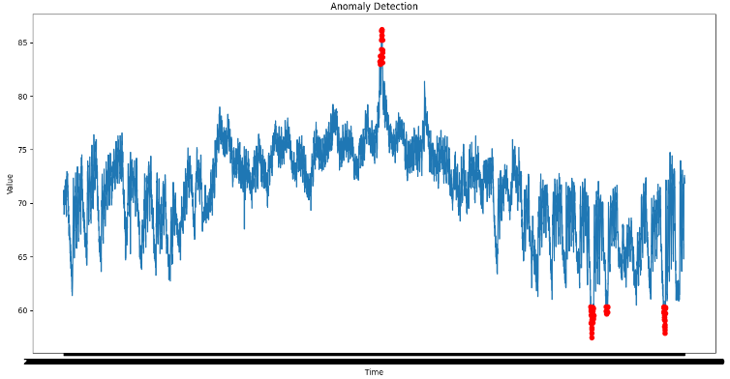
Concept Overview
Time-Series Anomaly Detection is a powerful technique that identifies unexpected behaviors or deviations from normal patterns in time-series data. In the healthcare domain, these anomalies could represent a sudden spike in patient admissions, irregular payment activities, or other irregularities that require immediate attention.

Slide 4
Relevant Trends
Growing Data Complexity
The increasing volume and complexity of healthcare data make manual monitoring impractical, driving the need for automated anomaly detection tools to manage data and provide actionable insights.
AI in Healthcare
AI, particularly in pattern recognition and predictive analytics, is revolutionizing healthcare operations, with advanced techniques like outlying aspect mining providing deeper insights into detected anomalies.
Focus on Patient Outcomes
There is a growing emphasis on improving patient outcomes through data-driven insights, and detecting anomalies in patient treatment and outcomes can help identify potential risks early.
Fraud Prevention
Anomaly detection is increasingly used to identify fraudulent activities in healthcare payments, and the ability to explain anomalies enhances the effectiveness of fraud detection systems.
Advanced Anomaly Detection Techniques
Modern approaches to anomaly detection focus not only on identifying anomalies but also on explaining why certain data points are considered anomalous, improving decision-making in healthcare operations.

Slide 5
Opportunities
Enhanced Operational Efficiency
Proactive Patient Care
Implementing time-series anomaly detection with outlying aspect mining can identify inefficiencies and explain their root causes, such as delays in patient processing, allowing for streamlined operations.
Detecting anomalies in patient data and understanding contributing factors enables earlier interventions, potentially preventing adverse outcomes and improving overall patient care.
Fraud Detection and Prevention
Data-Driven Decision Making
Anomaly detection, combined with outlying aspect mining, can identify fraudulent activities in real-time, reducing financial losses and ensuring compliance with regulatory standards.
Time-series anomaly detection provides healthcare organizations with actionable insights, enabling informed decisions that improve service quality and operational resilience.

Slide 6




False Positives
Data Privacy Concerns
Threats
Implementation Complexity
Dependence on Data Quality

Slide 7



Strategic Options for Cotiviti
Invest in AI-Driven Anomaly Detection Solutions
Develop Customized Anomaly Detection Models
Focus on Data Privacy and Security
Expand Service Offerings
Cotiviti should explore strategic partnerships with leading AI providers to integrate advanced anomaly detection tools, including outlying aspect mining, into its healthcare analytics platform.
Cotiviti can leverage its domain expertise and data assets to develop customized LSTM autoencoder models with outlying aspect mining, tailored to specific healthcare use cases, creating a competitive edge.
Ensure that Cotiviti's anomaly detection systems comply with strict data privacy regulations by investing in secure data processing frameworks to protect patient information.
By including real-time anomaly detection and outlying aspect mining in its service offerings, Cotiviti can provide added value to healthcare providers, improving patient outcomes and operational efficiency.

Slide 8
“Time-Series Anomaly Detection, combined with outlying aspect mining, offers significant opportunities for Cotiviti to enhance its healthcare analytics capabilities. By investing in AI-driven solutions and focusing on data privacy, Cotiviti can lead in providing proactive insights that drive better healthcare outcomes and operational efficiency.”
COTIVITI

Slide 9





Time-Series Anomaly Detection in Healthcare Operations: Opportunities and Strategic Directions
Anomaly Detection Using an LSTM Autoencoder
Data Simulation
Data Preprocessing
Anomaly Identification
Visualization
The code generates a synthetic dataset representing daily patient admissions over a year (365 days). Random anomalies are introduced to simulate unusual spikes or drops in admissions, which could indicate potential operational issues or irregularities.
The patient admissions data is standardized using StandardScaler to normalize the values. A sequence of data points is created where each sequence consists of 30 consecutive days of admissions to help the model learn temporal patterns.
An LSTM autoencoder model is designed and trained to learn the normal patterns in the time-series data. The model is trained to reconstruct the input sequences, and high reconstruction errors indicate the presence of anomalies.
The reconstruction error for each sequence is calculated, and a threshold is set at the 97th percentile to identify the top 3% of sequences with the highest errors as anomalies.
The time series of patient admissions is plotted, and anomalies are highlighted with red markers to provide an intuitive way for decision-makers to identify and address potential issues.

Slide 10
Time-Series Anomaly Detection in Healthcare Operations: Opportunities and Strategic Directions
Long Short-Term Memory (LSTM) networks are a powerful type of recurrent neural network that can capture long-term dependencies in sequential data, making them well-suited for time-series anomaly detection. When combined with autoencoders, LSTM models can learn to reconstruct normal patterns in time-series data, with anomalies detected when the model's reconstruction error spikes.

Slide 11
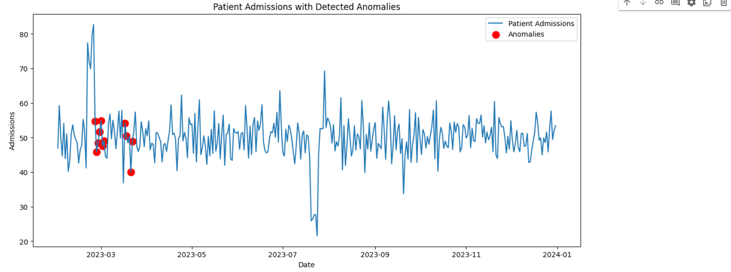
Hackathon Proof of Concept
This proof of concept demonstrates how machine learning, specifically LSTM autoencoders, can be applied to healthcare data to automatically detect anomalies. In a real-world scenario, this approach could be used to monitor patient admissions, treatment outcomes, or payment transactions, alerting healthcare providers to irregularities that may require further investigation. The visualization provides an intuitive way to see where these anomalies occur, helping decision-makers quickly identify and address potential issues.

